Slide 1
HISTOLOGY OF THE SMALL INTESTINE AND LARGE INTESTINE

Slide 2
Objectives
State the position of the duodenum
Describe the macroscopic structure of the duodenum
Describe the anatomical relationships of the duodenum
State the blood supply, lymphatic drainage & nerve supply of the duodenum

Slide 3
Objectives
state how the structure of the different parts of the small intestine differs from the general pattern of the gastrointestinal tract
state how the small intestine is adapted to perform its function.
describe the structure and functions of intestinal villi.
describe the functions of each cell type found in villi and crypts of small intestine.

Slide 4
Small intestine - Introduction
Humans over 5 years old - approximately 7 m (24 ft.) long
varies from 3 – 10 m (10-33 ft)
divided into three structural parts:
Duodenum : 25 cm ( 10 inches)
Jejunum : 2.5 m ( 8.2 ft)
Ileum : 3.5 m (11.5 ft)
much longer than the large intestine ( 4-5 times longer)
Average diameter of the of an adult human : 2.5-3 cm.

Slide 5
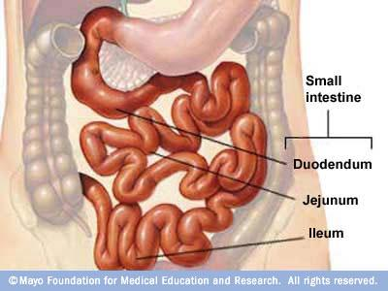
Small intestine - Introduction

Slide 6
Histology of the Digestive System: General
Has four distinct basic histological layers;
Mucosa
a. Epithelium
b. Lamina Propria
c. Muscularis Mucosae
(protective, secretory, absorptive, absorptive/protective)
Submucosa- loose collagenous tissue
“Plexus of Meissner”
Muscularis propria- smooth muscles (inner circular, outer longitudinal)
Stomach: ??
Myenteric plexus/Auerbach’s Plexus
Adventitia – loose connective tissues(serosa/visceral peritoneum, mesothelium)

Slide 7
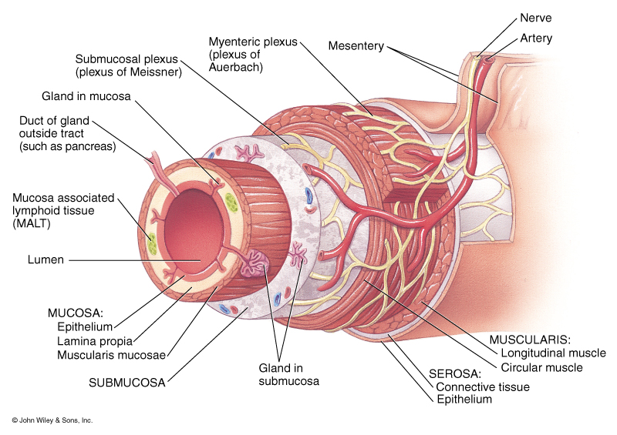
Histology of the Digestive System: General

Slide 8
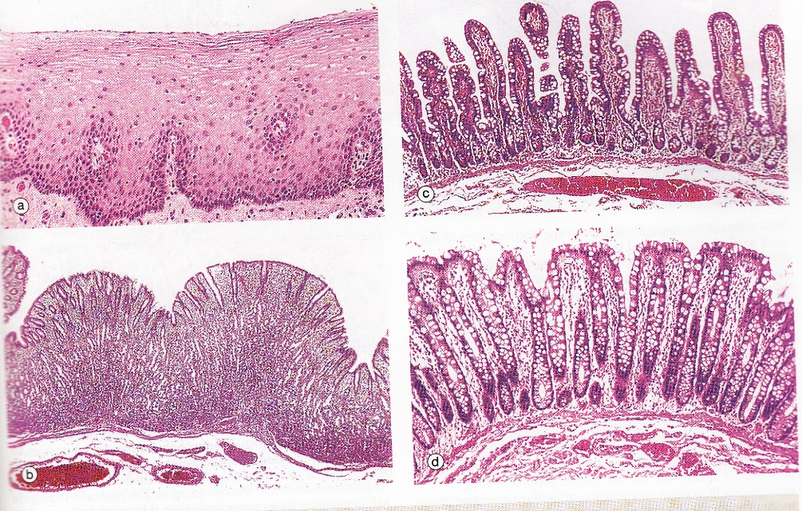
PROTECTIVE
ABSORPTIVE
SECRETORY
ABSORPTIVE/PROTECTIVE

Slide 9
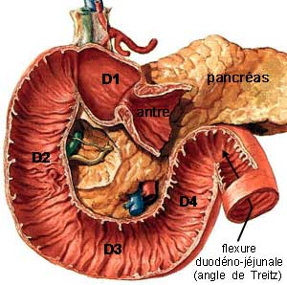
Duodenum
First part of small intestine
Neutralize gastric acid and pepsin-
Is the site of food digestion, nutrient absorption, endocrine secretion
Permit prolonged contact of food with enzymes
Mucosa, submucosa, muscularis propria, serosa/ fibrosa

Slide 10
Gastroduodenal junction
Mucosa
Abrupt transition from the glandular (secretory) arrangement
(stomach)
villous (absorptive ) arrangement
(duodenum)
Has characteristic villi with short glands known as crypts of Lieberkuhn extending to the muscularis mucosa
Scattered goblet cells – produce mucin in the villi and crypts
Submucosa
Numerous mucous secreting glands- Brunner’s gland
Muscularis propria
Inner circular and outer longitudinal smooth muscles

Slide 11
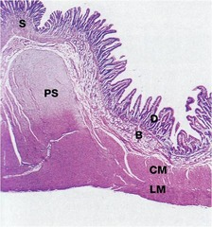
Gastroduodenal junction
Pyloric sphincter (PS) –
Marked thickening of the circular layer of the muscularis propria
Brunner’s Glands

Slide 12
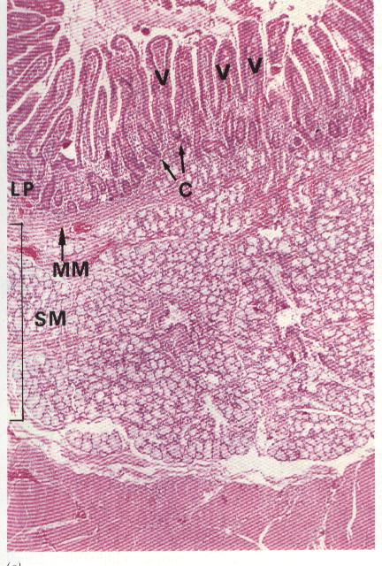
Brunner’s glands
Predominantly in submucosa. Can extend to mucosa
Distinguishing feature from the rest of the SI
Branched tubular mucous glands
Ducts pass through the muscularis mucosa to open into the crypts
Tall columnar cells with poorly stained cytoplasm and basally placed nuclei
Secrete thin alkaline mucous neutralize the acidic chyme
Prevent duodenal mucosa from auto digestion

Slide 13
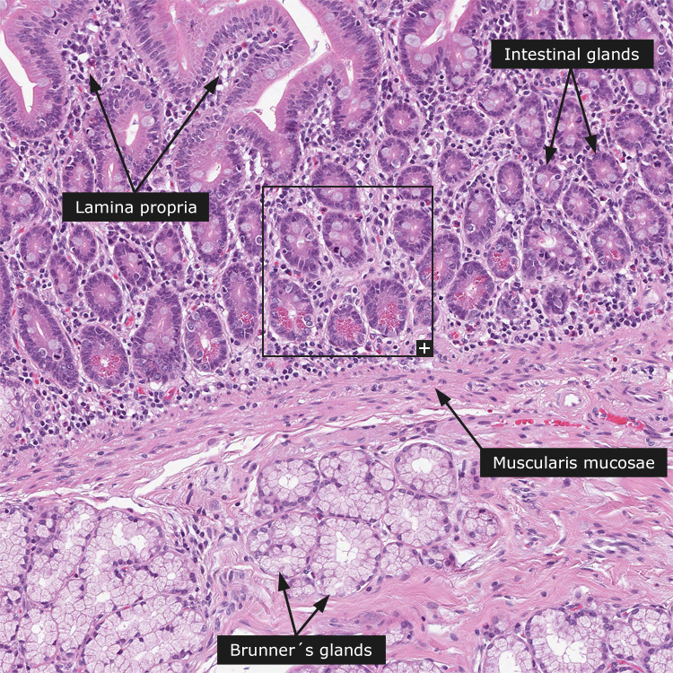
Duodenal mucosa
Other products of Brunner’s glands
Lysozyme
EGF
Secretin
CCK
Promotes pancreatic
exocrine secretion
Secrete by the duodenal
mucosa
Promotes GB contraction and propelling
Bile into the common bile duct

Slide 14
Plicae circulares
Series of permanent transverse folds in the mucosa- “plicae circulares or valves of Kerckering or valvulae conniventes”
Covered with villi
Feature to increase the surface area for its function
Consists of mucosa and vascular submucosa
Semilunar , circular or spiral form
Most developed in jejunum and proximal ileum, and are generally absent in proximal duodenum and distal ileum.

Slide 15
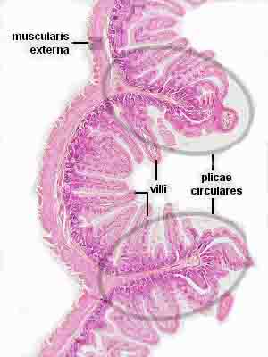
Circular folds

Slide 16
DOUDENUM | JEJUNUM / ILEUM
Brunner’s glands are there | No Brunner’s glands
Villi tend to be long | Villi becomes shorter towards the ileum
Lymphoid tissues- less prominent/inconspicuous | Lymphoid tissues- more prominent
Less goblet cells | Goblet cells increase distally
Absent or less developed | Plicae circulares present

Slide 17
Briefly describe the structural adaptations of the small intestine to increase the surface area? (15marks)

Slide 18
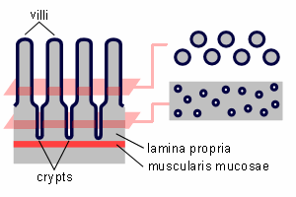
Intestinal villi and crypts

Slide 19
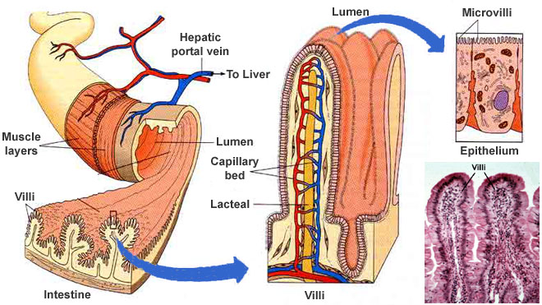
Intestinal villi

Slide 20
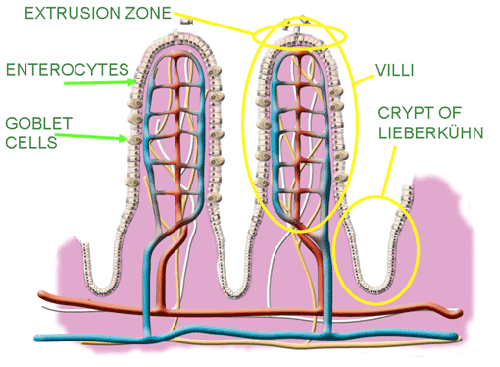
Intestinal villi
Lined by simple columnar epithelium continuous with crypts
Cell types
1. Enterocytes:
Most numerous
Tall columnar cells
Surface microvilli- brush/striated border in LM
Between microvilli surface digestion occur
Main absorptive cells
Short lifespan(2-3d)

Slide 21
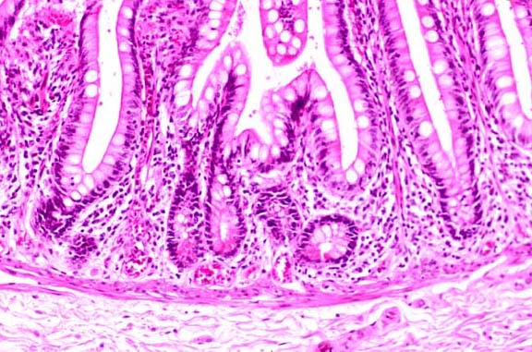
Intestinal villi
2. Goblet cells:
Scattered among enterocytes
Produce mucin and then hydrate to form mucus
Protect and lubricate the epithelium

Slide 22
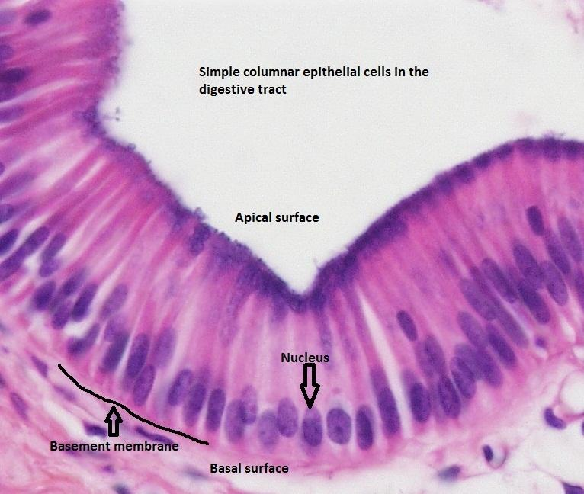
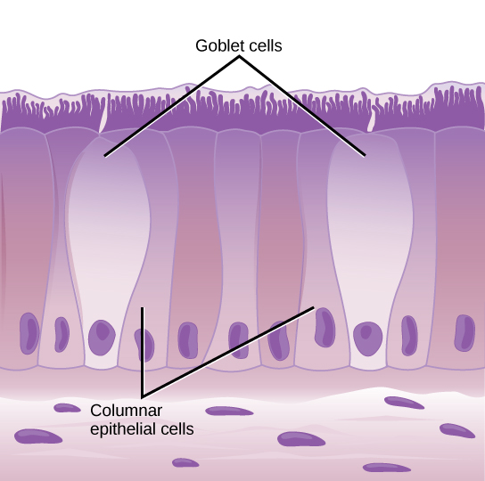
Simple columnar epithelium

Slide 23
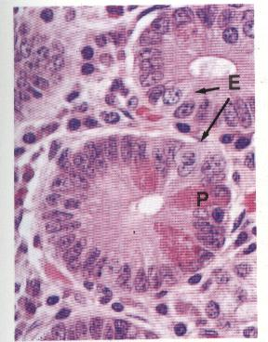
3. Paneth cells:
Found at the base of the crypts
Distinguish by their prominent eosinophilic apical granules
These have antimicrobial peptide : defensins
Has first line of defensive function (innate immunity)
Regulating the microenvironment of the crypt
Long lifespan (wks)

Slide 24
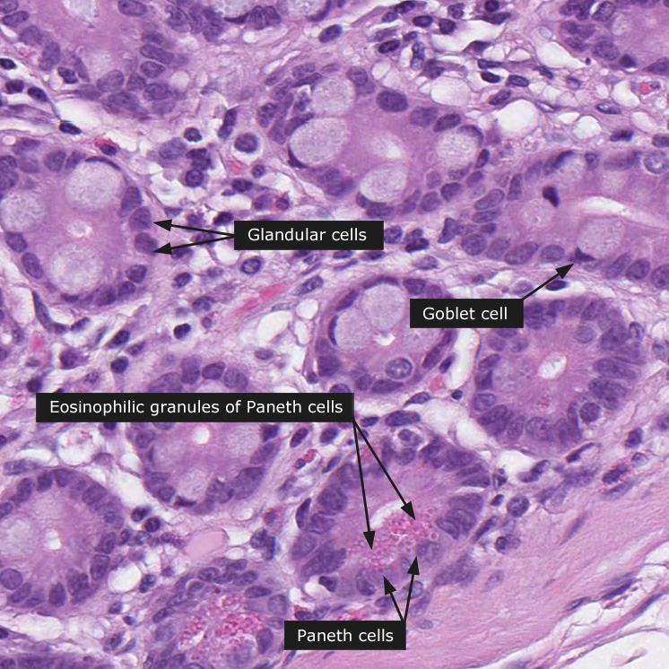

Slide 25
4. Neuroendocrine cells
Produce locally acting hormones - regulates GI motility and secretion
Secrete peptide hormone,
cholecystokinin-pancreozymin (CCK)
Secretin
Somatostatin
Serotonin
Enteroglucagon
5. Stem cells:
At the base of the crypt
Replenish all the above cell types
6. Intraepithelial lymphocytes:
Mostly T cells
Provide defense against micro organisms
Stimulate exocrine pancreatic secretion

Slide 26
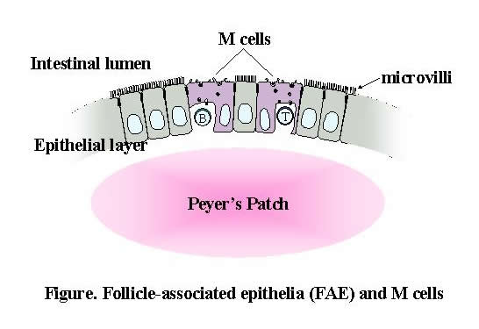
7. M cells/microfold cells
Specialized cells for immune function
In the mucosa of the ileum overlying the lymphoid follicles
Characteristic feature- presence of basal invaginations/ pockets
Contain intraepithelial lymphocytes and APCs

Slide 27
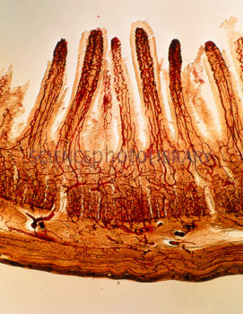
Intestinal villi
The villous core has
Capillaries
Extensions of laminar propria of loose supporting tissues
Lacteal : at the center
Smooth muscle fibres extending from the muscularis mucosae
Blood vessels
Long loop of branching capillaries originating from the dense capillary network in the submucosa
Extend up to tip of the villi
Most of the food particles (monosaccharides and AAs) except lipid components enter the blood vessels via enterocytes and transport to the hepatic portal vein

Slide 28
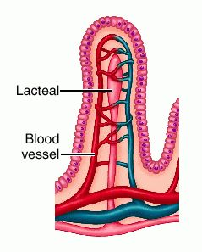
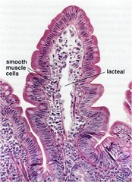
Intestinal villi
Lacteal
Center of the villus
Transport absorbed lipids in to the circulatory system via thoracic duct

Slide 29
Intestinal villi
Smooth muscle fibres
Produce rhythmic movements of the villi (increase the absorption efficacy)
Produce local movements of the plicae circulares

Slide 30
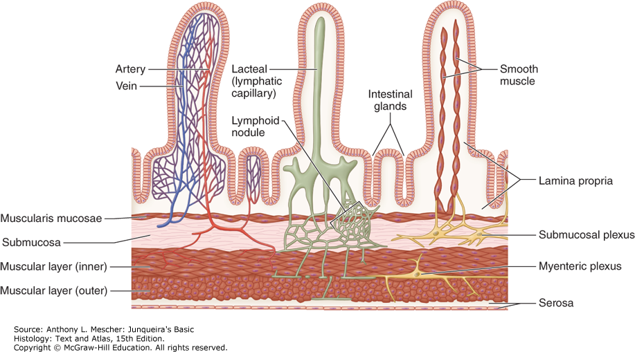
Microvasculature, lymphatics and muscle in villi

Slide 31
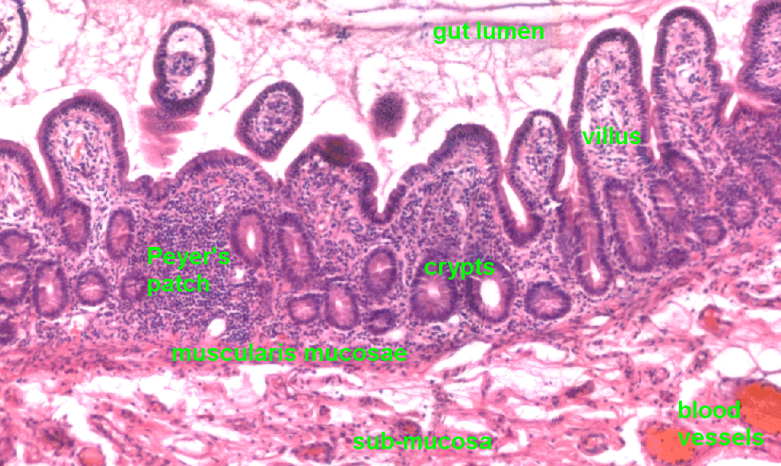
Peyer patches
Aggregated lymph nodules (follicles)
In the lamina propria of the ileum on the anti- mesenteric border.
MALT

Slide 32
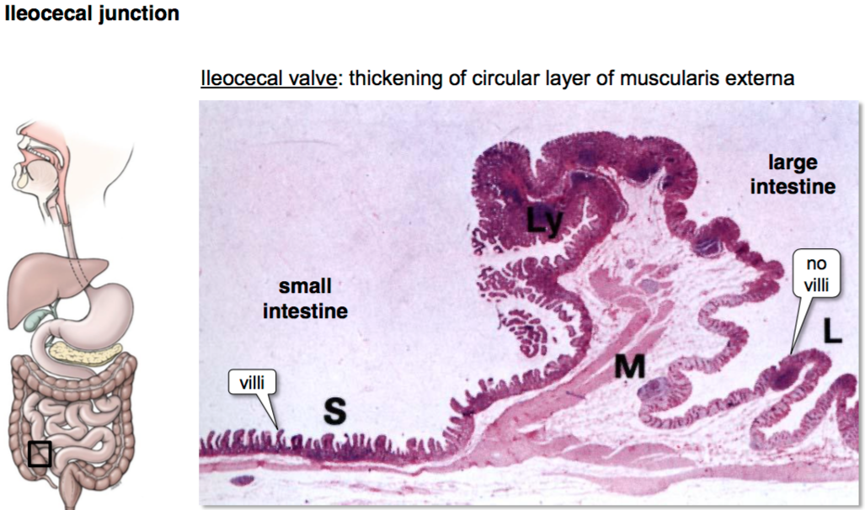
Ileocaecal Junction
Abrupt transition of the mucosa from villi form pattern to glandular form in the large intestine
Ileocaecal valve- thickened extension of the muscularis propria

Slide 33
Colon
Two types of cells arranged in closely packed straight tubular glands/ crypts
Absorptive cells/colonocytes –
entire luminal surface of the gland
tall columnar cells- absorb water and salts
Goblet cells –
Predominantly in the base of the gland
Secrete mucous- helps to lubricate and protect the mucosa
Stem cells
Intraepithelial T cells
Lymphocytes aggregates are there in LP and submucosa but smaller than payer patches

Slide 34
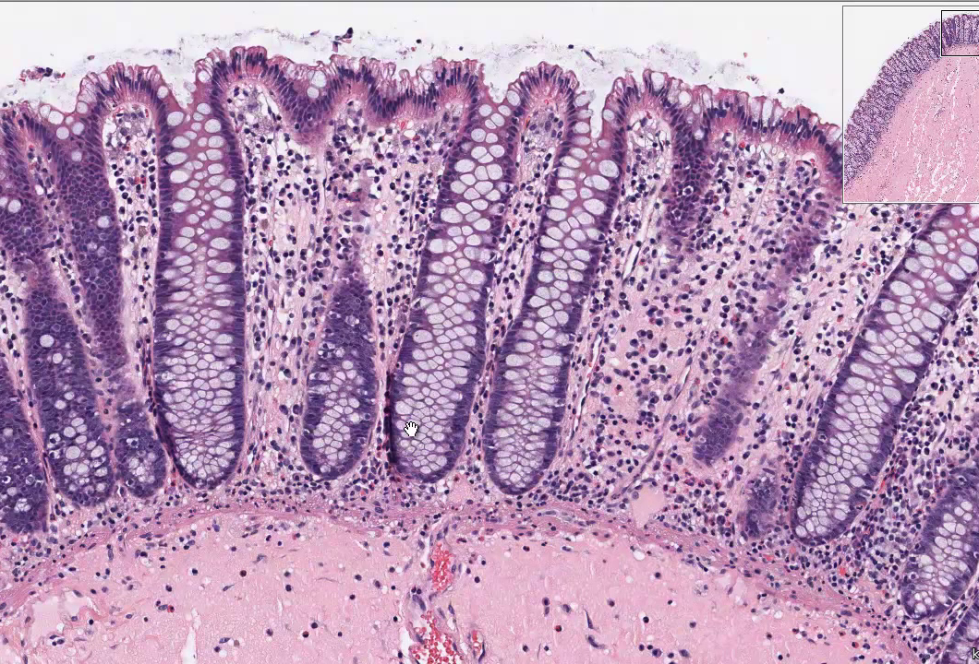
Colon

Slide 35
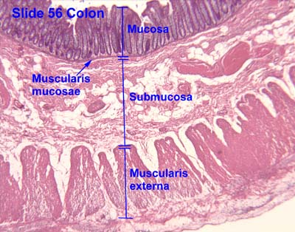
Colon
Functions:
Recovery of water and salt from faeces
Propulsion of solid faeces towards the anus- MP – thick in order to provide powerful peristaltic activity
Outer longitudinal layer- taeniae coli(3 separate longitudinal bands)

Slide 36
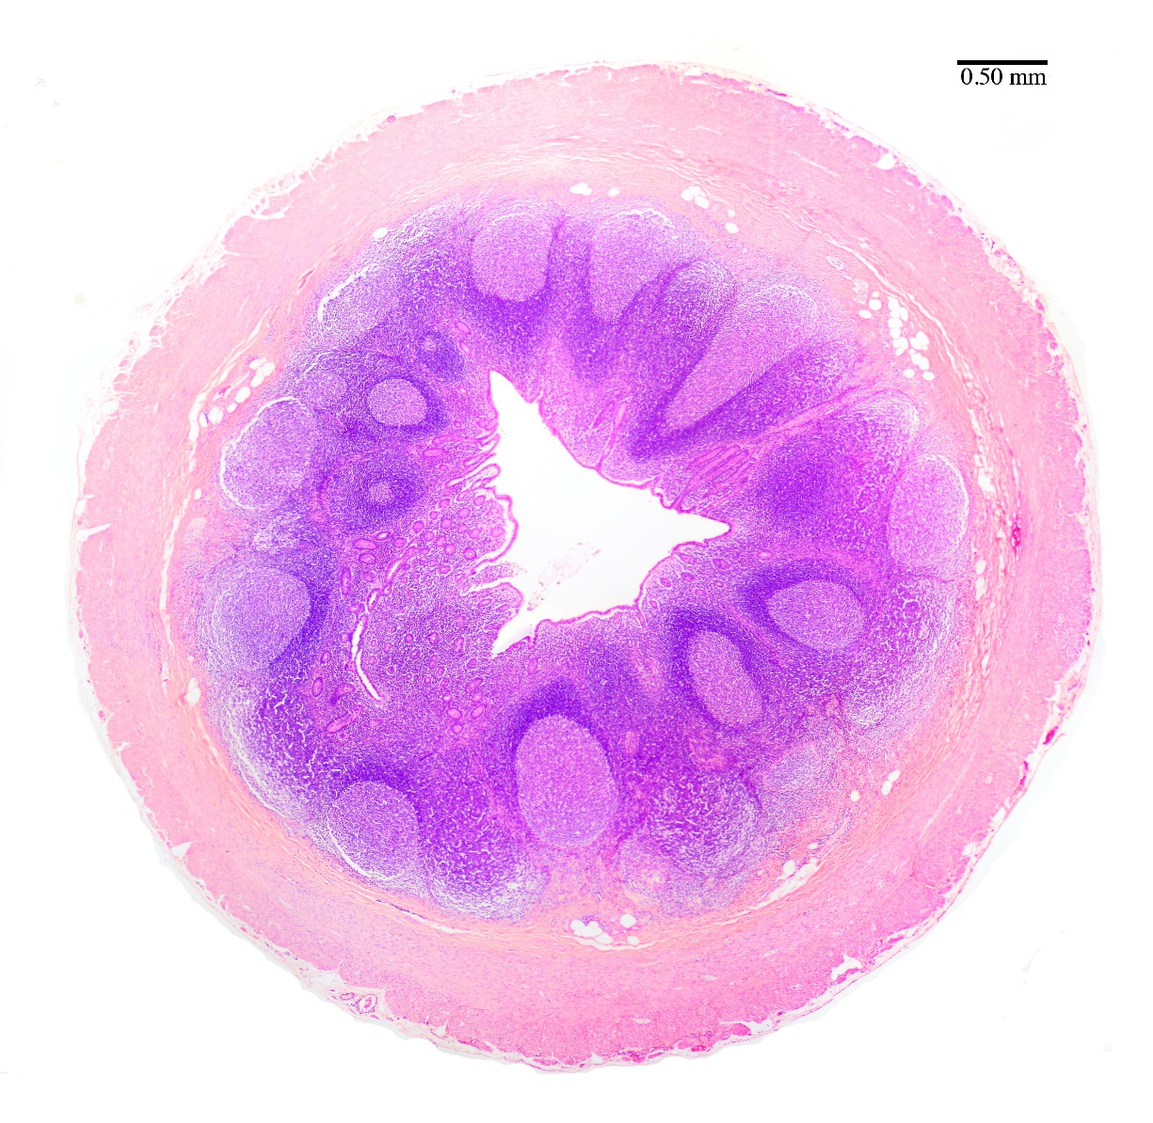
Appendix
Presence of masses of lymphoid tissues in mucosa and submucosa
Arranged in follicles also
Mucosal glands are less closely packed
MALT

Slide 37
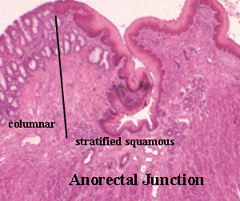
Rectum and anorectal canal
Rectal mucosa is same as rest of the large bowel
At anorectal junction- abrupt transition to stratified squamous epithelium in the anal canal

Slide 38
Clinical significance

Slide 39
Coeliac Disease
Gluten sensitive enteropathy/sprue
Immunological reaction to gluten and immune response damage the small bowel mucosa
Contains in wheat, oats, barley, rye
P/C-
Malabsorption
Weight loss
Diarrhoea
Steatorrhoea
Anaemia
Vitamin deficiencies
Endoscopic Bx: Loss of surface villi and elongation of crypts (due to increased stem cells turn over)
Non specific changes and the diagnosis is confirmed by resolution of symptoms after a period of gluten free diet

Slide 40
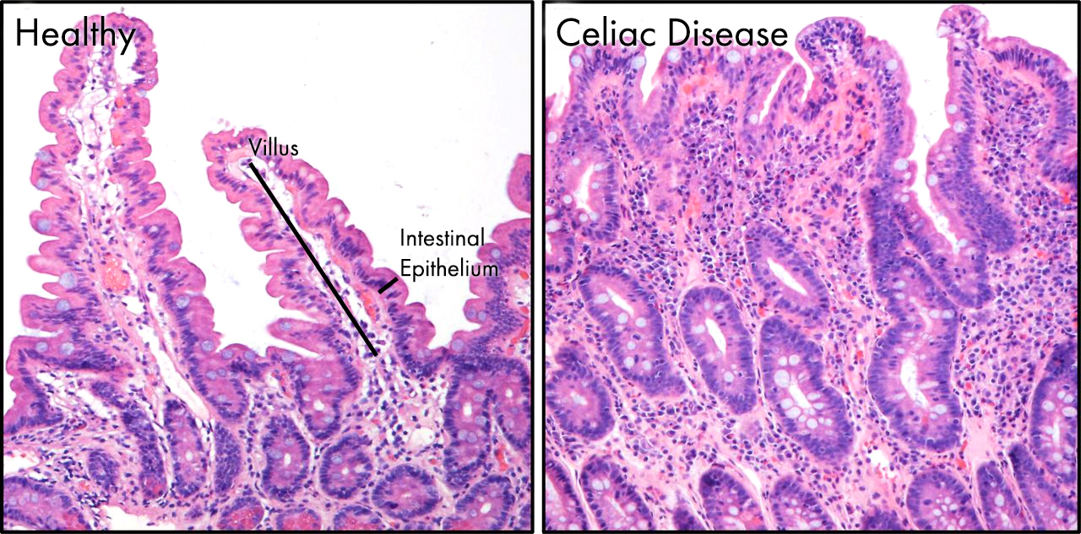
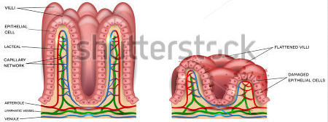
Coeliac Disease

Slide 41
Crohn disease and Ulcerative colitis
IBD
Pathogenicity: Immune, genetic, environment
P/C- pain, localized bleeding, malabsorption, diarrhea
Leiomyomas- common benign tumor in SM

Slide 42
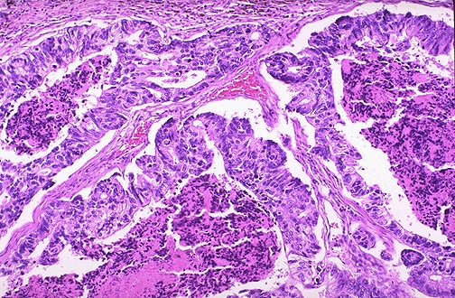
Adenocarcinoma of the colon
Adenoma- carcinoma- sequence
Develops on top of benign polyps
Common with individuals with low fiber diet
Genetic predisposition (FAP, HNPCC)
Prevention- by screening

Slide 43
Which of the following are true regarding the Brunner glands
Branched tubular mucous gland
It secretes alkaline mucus
It secretes epithelial growth factors
It is nonspecific for the duodenum
It secretes secretin hormone
TTTFF

Slide 44
Regarding the small intestine
Brunner glands are sub mucosal glands
Aggregated lymphoid follicles are abundant in the terminal part of the ilium
Circular folds are generally absent in the duodenum
Arterial arcades are longer in the jejunum than the ilium
Mesenteric fat content is more in the ilium than in the jejunum
TTTTT

